Slide 1


Notes:
Create your own Fact/slogan here: https://coolblueblauwdruk.nl/en/huisstijl/feit-slogan-generator

Slide 2
Techvriendjes
Jouw foto hier
Welkom! Even voorstellen...
Ik ben ...
Ik hou van...
en een andere interessant punt

Slide 3


Slide 4

Programmeren door spelen
Wat is CodeCombat?
CodeCombat is een spel om mensen te leren programmeren.
Door puzzels op te lossen en ogres te verslaan, doorlopen spelers de spelniveaus om steeds complexere programmeerconcepten te leren!

Slide 5
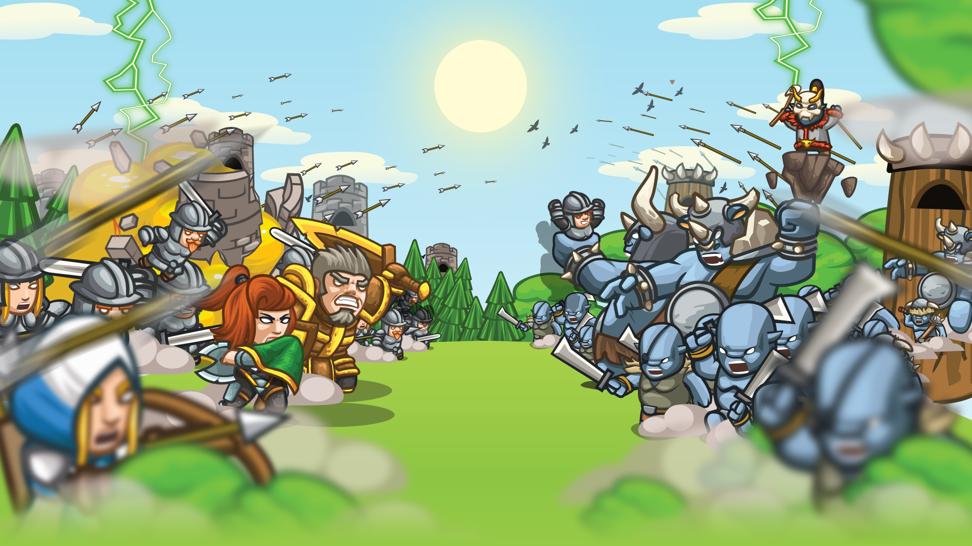

Slide 6
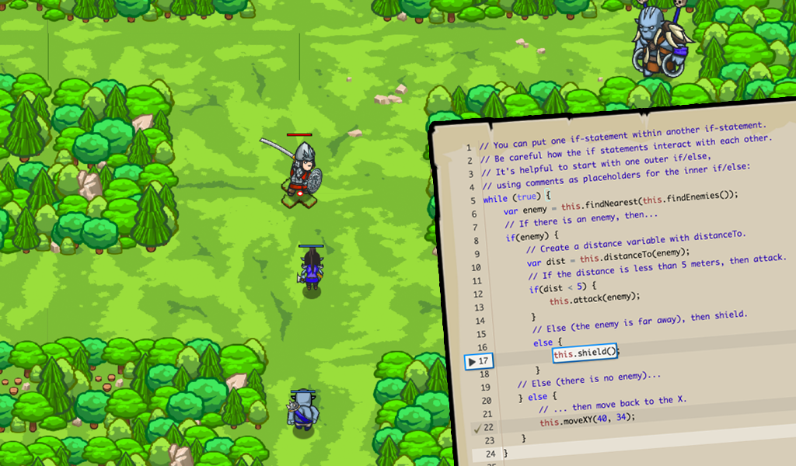

Slide 7
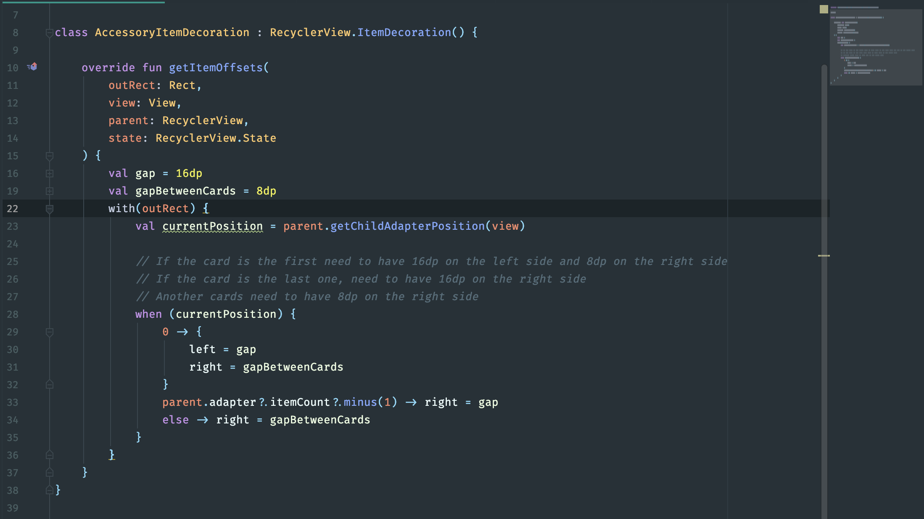

Slide 8

Succes!

Slide 9

DEMO TIJD: Hoe ver ben je gekomen?

Slide 10


Slide 11
Content licensed under CC BY NC SA 4.0
You are free to:
Share — copy and redistribute the material in any medium or format
Adapt — remix, transform, and build upon the material
Under the following terms:
Attribution — You must give appropriate credit, provide a link to the license, and indicate if changes were made. You may do so in any reasonable manner, but not in any way that suggests the licensor endorses you or your use.
NonCommercial — You may not use the material for commercial purposes.
ShareAlike — If you remix, transform, or build upon the material, you must distribute your contributions under the same license as the original.
No additional restrictions — You may not apply legal terms or technological measures that legally restrict others from doing anything the license permits.
This presentation was based off the content at https://github.com/devoxx4kids/materials/

Slide 12
